Slide 1

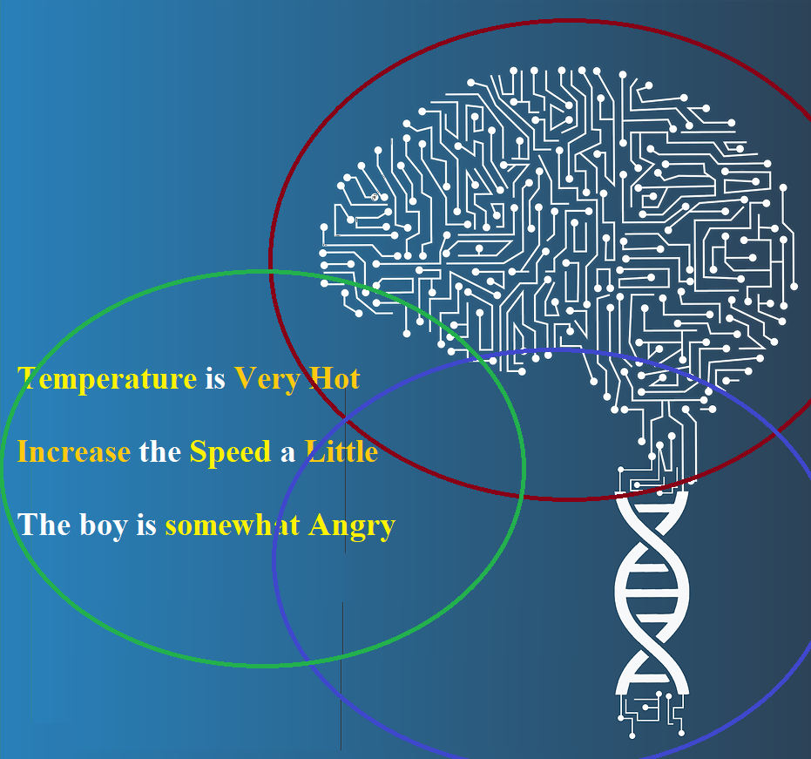

Slides 2 – Multiple Intelligence,
AI Foundations, History,
AI Approaches
Dr. Talha Waheed
Department of Computer Science, UET, Lahore

Slide 2
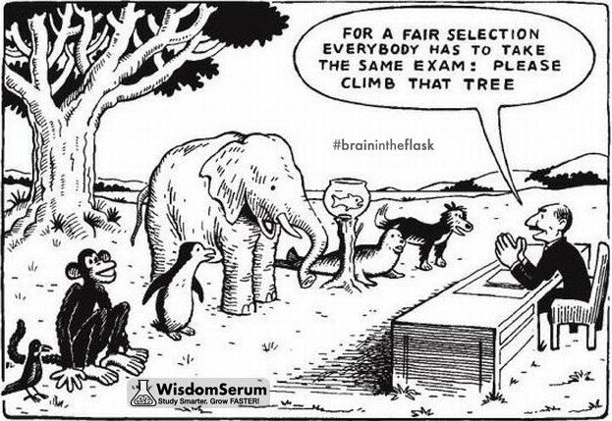
Single vs Multiple Intelligence
Everybody is a genius. But if you judge a fish by its ability to climb a tree, it will live its whole life believing that it is stupid.

Slide 3
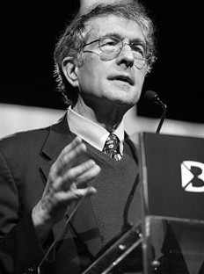
Theory of Multiple Intelligence by Howard Gardner*
The ability to find and solve problems, or to create products that are valued within one or more cultural settings.
* 29 honorary degrees
* Gardner was a professor of cognition and education psychology at Harvard. Source: “Frames of Mind”, 1983.

Slide 4
Theory of Multiple Intelligence
Previously a single intelligence theory that cannot be changed, and measurable by psychological tests.
IQ testing, did not fully and accurately depict a person's abilities.
Gardner supports that intelligence comes in many forms
initially claimed that humans have 7 (now 9) different types of intelligence
Theory of multiple intelligence is a psychological theory of the mind.
intelligence is not inborn, fixed trait of human that dominates all skills and abilities.
brain damage may diminish one area, while excelling in another.
A pluralized and distributed way of understanding intellect.
That guides in career counselling and AI solutions implementation (divide and conquer).

Slide 5
Gardner’s 9 Types of Human Intelligence
Verbal-Linguistic (Language) Word Smart | Mathematical-Logical (Numbers) Number/ Reasoning Smart | Visual-Spatial (Pictures/ Maps/ Puzzles) Picture Smart
Bodily-kinesthetic (Physical Experiences) Body Smart | Inter-personal (Retrospection/ Relating to others) People Smart | Intra-personal (Self-Reflection/ Introspection) Self Smart
Musical-Rhythmic (Musical/ Sounds) Sound Smart | Naturalist (Environment, Plants) Nature Smart | Existential (Spiritual/ Multiple Perspectives/ Big Picture) Purpose Smart
Few Others
Emotional (EQ): Ability to perceive, evaluate, and manage emotions while handling interpersonal dynamics empathically.
Creative: The skill to bridge unrelated concepts, innovate, and bring brand-new ideas or visions into reality.
Moral: The capacity to navigate complex ethical dilemmas and determine right from wrong when standard rules fall short

Slide 6
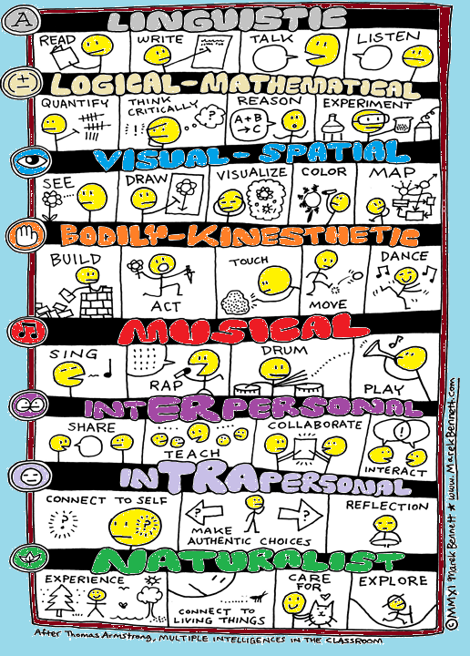
Some Verbs associated with each Type of Intelligence

Slide 7
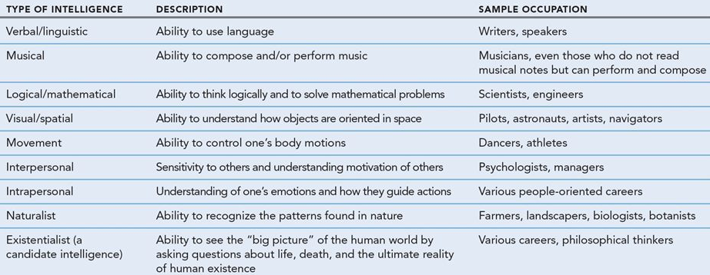
Gardner’s Theory of Intelligence - Careers

Slide 8
To resolve the puzzle of Intelligence
Understand Human Intelligence. (Broad - Computational Intelligence)
AI is kind of a lab (medium) for testing theories of (human) intelligence:
(such theories may be stated in the language of computer programs and tested and verified through the execution of these programs on a machine.)
Design Intelligent Systems. (Narrow - Artificial Intelligence)
Branch of computer science that is concerned with the automation of intelligent behaviour.
Typically deals with subjects like
data structure, algorithms, programming languages and techniques

Slide 9
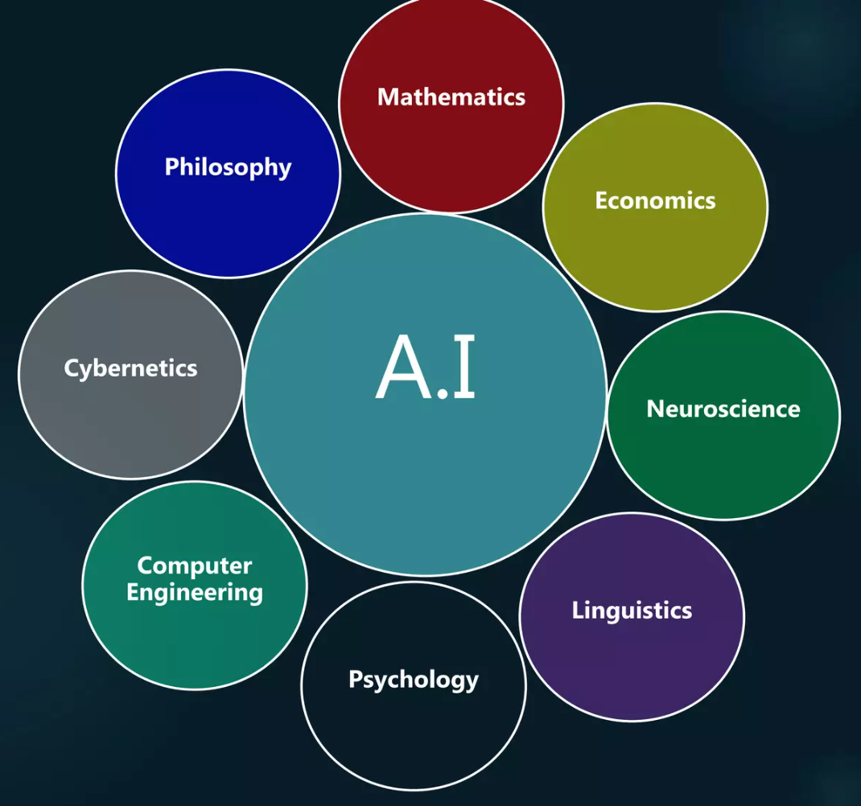
Foundations of Computational Intelligence
Philosophy – reasoning, logic, mind, language
Maths & Stats –probability, regression, computation,
Psychology – human mind, behavior, learning
Computer science –Algorithms, simulation tools
Linguistics – Structure and meaning of Natural Languages
Physics – Simulated Annealing, Chaos Theory
Biology – Neural Networks, Genetic Algorithms
Computer Engineering – Wavelets, robotics, GPUs
Economics – Decision theory, game theory, operations research

Slide 10
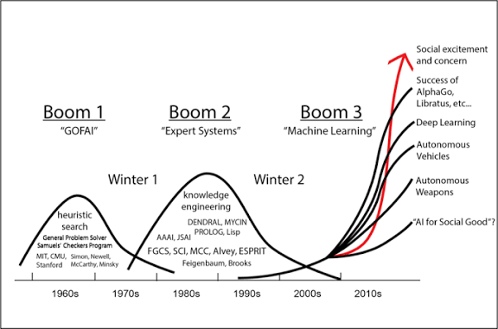
History of AI – Three Booms (Springs)

Slide 11
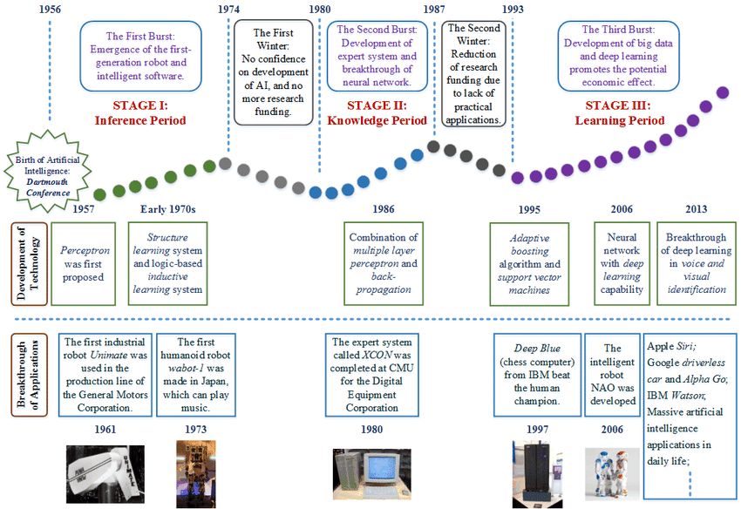
History of AI – Three Booms (Springs)

Slide 12
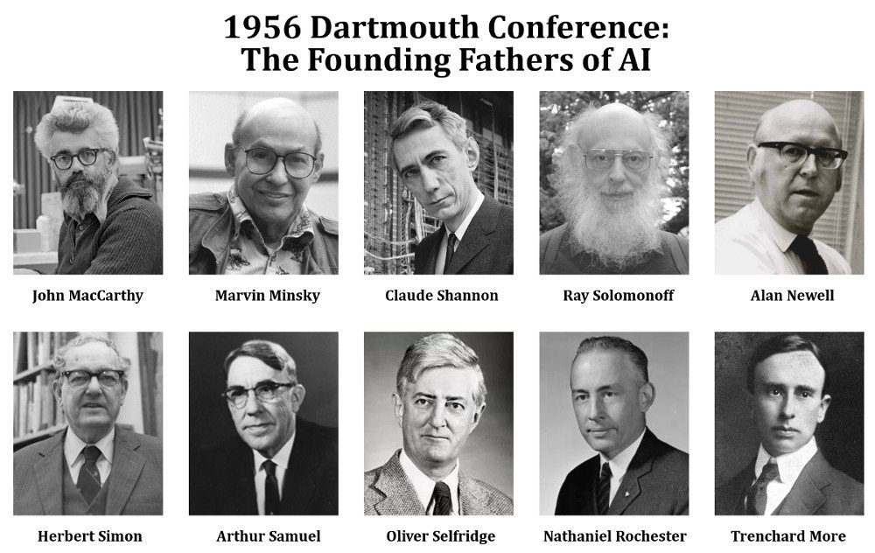
History of AI
1943 - 1956
  McCulloch Pitts Neuron
  Chess program by Turing and Shannon
  Hebbian Learning (used in SNARC)
  SNARC - first Neural Computer (40 neurons) by Minsky (1951)
  Dartmouth Workshop – Name AI by John McCarthy (1956)
1952 - 1969 - Enthusiasm/Great Expectations
  General Problem Solver - imitate human problem solving Newell, Simon
  Lisp Language, Shakey Microworlds Robot, Blocks world problem
  Neural Net - Widrow learning, Rosenblat Perceptron

Slide 13
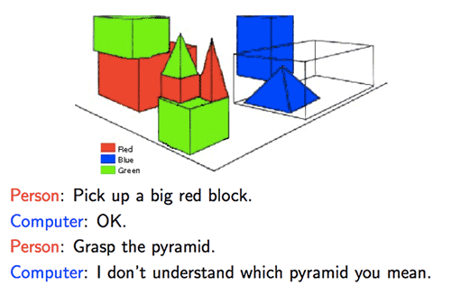
History of AI
1966 - 1974 - A Dose of Reality
  Complexity of Machine Translation
  Intractability of many AI problems
  Machine Evolution (Genetic Algorithms) Failure
  XOR problem - Limitation of Perceptron by Minsky
1969 - 1979 - Knowledge based system
  Weak Methods - General purpose search
  Expert Systems - Mycin for Bacterial Infections (450 rules, Explainable AI, 70% success)
  SHRDLU for Natural Language Understanding of Blocks World (MIT)
  Prolog, Concepts of Frames by Minsky

Slide 14
History of AI – 2nd Boom
1980- 1988 AI becomes an Industry
  Expert Systems at DEC saved 40 million US$, configures orders for new computer systems.
  Prolog and Fifth Generation Languages Project by Japanese
  Fear of Japanese domination - Heavy Funding for Lisp, Robotics, Expert Systems (manufacturing industry automation)
History of AI – 3rd Boom
1986 - Present - return of Neural Networks, Machine Learning
  Parallel Distributed Processing by Rumelhart
  neural networks vs. traditional AI
  Emergence of Soft Computing (Fuzzy Logic, NN, GA, etc)
  Application oriented and Behavior Based AI
  Emphasis on mathematical rigor (Neats vs. Scruffis)
  Pattern Recognition (HMM), Planning, Belief Networks, Whole Agent Approach, Knowledge Representation, Vision & Robotics, Machine Learning
  Thousands of Applications in practical use noe
2020 - LLMs, ChatGPT, Agentic AI, AGI, Super AI ….

Slide 15
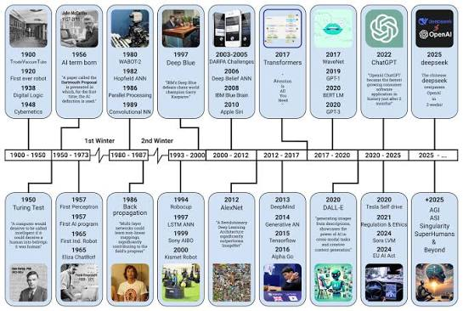

Slide 16
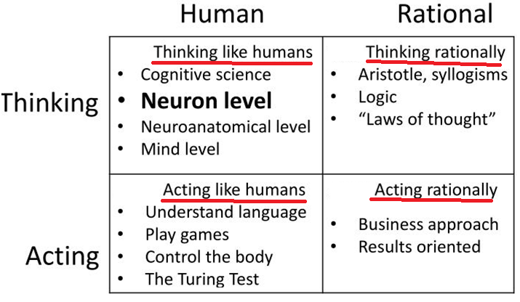
4 Approaches to Implement AI
Human Centred – Empirical Sciences
Rationalist – Logic, Maths and Engineering

Slide 17
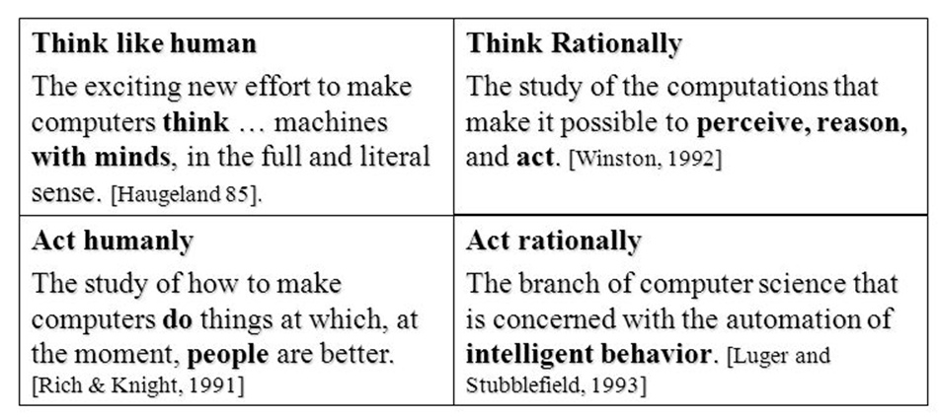
AI Definitions of 4 Approaches

Slide 18
Acting Humanly: Turing Test Approach
Turing Test is helpful when AI program have to interact with people
Underlying representation and reasoning may not be based on human model.

Slide 19
Turing Test
Intelligent Behavior
Turing defined Intelligent Behavior as the ability to achieve human-level performance in all cognitive tasks, sufficient to fool an interrogator.
Turing Test
Computer should be interrogated by a human via the teletype and passes the test if the interrogator cannot tell if there is a computer or a human at the other end
Required Capabilities
  Natural Language Processing – to communicate
  Knowledge Representation – to store information
  Automated Reasoning – to draw conclusion
  Machine Learning – to adapt new circumstances
Criticism on Turing Test –
  Only symbolic problem solving (no perception)
    Total Turing test (add 2 more capabilities Vision, Robotics)
  Needlessly fits machine to human intelligence
  A distraction from general theories to explain human and machine intelligence

Slide 20
Thinking Humanly - Cognitive Modelling
How humans think?
  Introspection - Subjective Experience
  Psychological Experiments
Simulate the mind and compare reasoning steps with humans
vs. Get right answer regardless of how humans might do it
This approach is helpful in vision, natural language and learning

Slide 21
Thinking Rationally - Laws of Thought Approach
Laws of thought (Logic) were supposed to govern the operation of mind
E.g. Syllogism by Aristotle
  All birds are animals. All parrots are birds. → So all parrots are animals.
2 Main Obstacles
  Difficult to take informal knowledge and state in formal terms
  Difference in problem solving “in principle” and “in practice”

Slide 22
Acting Rationally - Rational Agent Approach
Acting to achieve one’s goal given one’s beliefs
Agent is something that perceives and acts
So AI is study and construction of rational agents
Skills needed for Turing Test allow rational actions
Difference with “Law of Thought approach”
Making correct inference is part of rational agent
there are situations where there is no correct thing to do yet something must still be done

Slide 23
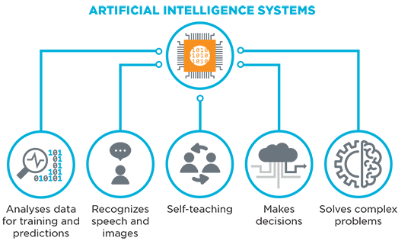
AI Typical Tasks
Routine tasks
  Perception
    Vision
    Speech
  Natural Language
    Understanding
    Generation
    Translation
  Common sense reasoning
  Robot control
Formal tasks
  Games
  Mathematics
    Geometry
    Logic
    Integral calculus
Expert tasks
  Engineering
  Scientific analysis
  Medical diagnosis
  Financial analysis

Slide 24
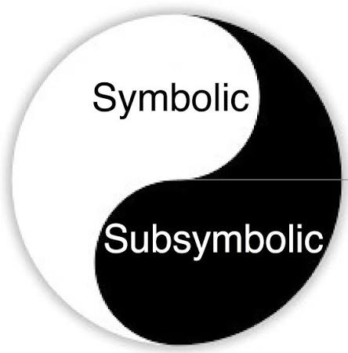
Another Classification of AI Approaches
Symbolic
Classical AI: (“Good-Old-Fashioned AI”)
Intelligent behavior is the result of a Physical symbol system (➔)
Logical, top-down, designed behavior, knowledge-intensive
Sub-symbolic (Connectionist)
Modern AI: Biological and Social based, e.g. Neural Nets ans Swarm Algorithms
Intelligent behavior is the result of connection processing
Biological / Social, bottom-up, emergent behavior, learning-based

Slide 25
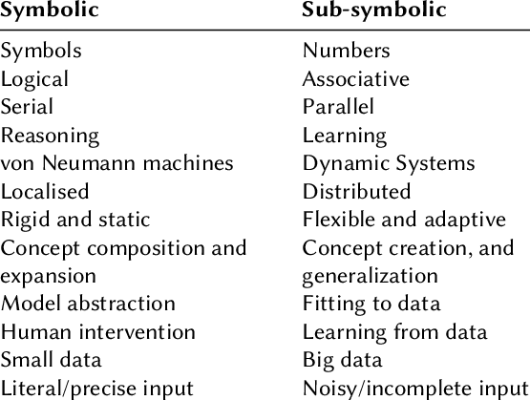
Important AI Research Areas (by Two Major Approaches)
Symbolic AI
Expert Systems
Intelligent Agents
Natural Language Processing and Semantic Modeling
Planning and Robotics
Machine Vision
Game Playing
Automated Reasoning and Theorem Proving
Statistical AI
Probabilistic Reasoning
Belief Networks
Sub Symbolic (or Connectionist) AI
Neural Nets
Genetic Algorithms and Evolutionary Programming
Artificial Life
Machine Learning

Slide 26
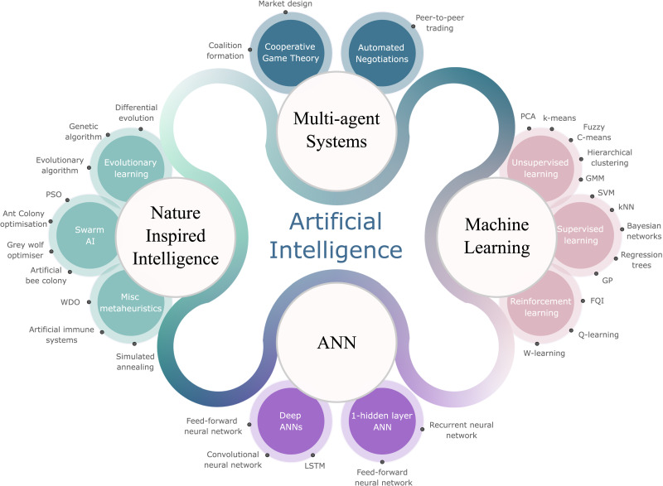
Sub-Areas of Sub-Symbolic (or Modern) AI

Slide 27
Typical Tasks of Classical AI
Classical (or Symbolic) AI - (1950 to 1990)
where if-then rules are absolute and can be comprehensively mapped by human experts
Logical Puzzle Solving & Board Games:
(e.g., IBM's Deep Blue defeating Garry Kasparov at chess in 1997 by calculating millions of hand-coded move sequences)
Expert Systems (Knowledge Processing):
Diagnosing specific issues in MYCIN using "if-then" rules compiled from human professionals
(e.g., early medical diagnostic systems or financial fraud rulesets).
Deterministic Pathfinding (& Optimization):
Finding shortest route on a graph or solving scheduling problems using strict mathematical constraints.

Slide 28
Typical Tasks of Modern AI
Since 2010 AI leverages deep neural networks and massive computational power.
Instead of being told what the rules are, it calculates mathematical probabilities (weights) based on its training.
Perception and Computer Vision :
Automatically identifying and classifying objects within raw images and video
(e.g., facial recognition, autonomous driving object detection).
Natural Language Processing :
Understanding context, translating languages fluidly, and powering sophisticated chat interactions.
Generative Content Creation:
Synthesizing text, code, image, etc based on patterns learned from existing data (ChatGPT, Claude, Gemini).
Advanced Intuitive Strategy:
Solving incredibly complex, fluid problems without human instruction (e.g., Google's AlphaGo inventing original strategic moves to defeat human champions).

Slide 29
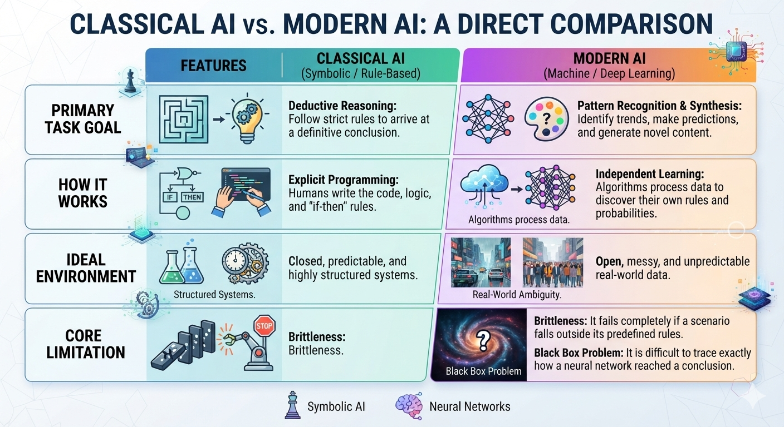

Slide 30
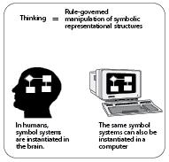
Symbolic AI is based on Physical Symbol System Hypothesis
A physical symbol system has necessary and sufficient means for general intelligent action[Newell & Simon, 1976]
A (machine/computer) can manipulate symbolic data, rearrange lists of symbols, replace symbols and so on
Symbol manipulation is essence of both human and machine intelligence,
(brain also process symbols?).
That means Intelligent activity is achieved through use of ?
• symbol patterns (letters, numbers, or electronic signals)
to represent the problem
• operations based on a set of instructions (rules or programs) on
those patterns to generate potential solutions (in words, expressions)
• search to select a solution among the possibilities (state space)

Slide 31
A Simple Example of Symbol System: Playing Chess
The Symbols:
Computer represents the board using symbols. For instance, WK (White King), BP (Black Pawn), and coordinates (E4 or E5) represent positions.
The Expressions:
AI combines these symbols to map current state of game ("WK at E1, BP at E5").
The Rules (Processes):
Program has rules for how these symbols can move ("If BP is at E5, move to E6 if it is empty").
The Intelligent Action:
By processing these symbols and looking ahead at different combinations of moves
using its rules, the computer decides on the best move to win the game.

Slide 32
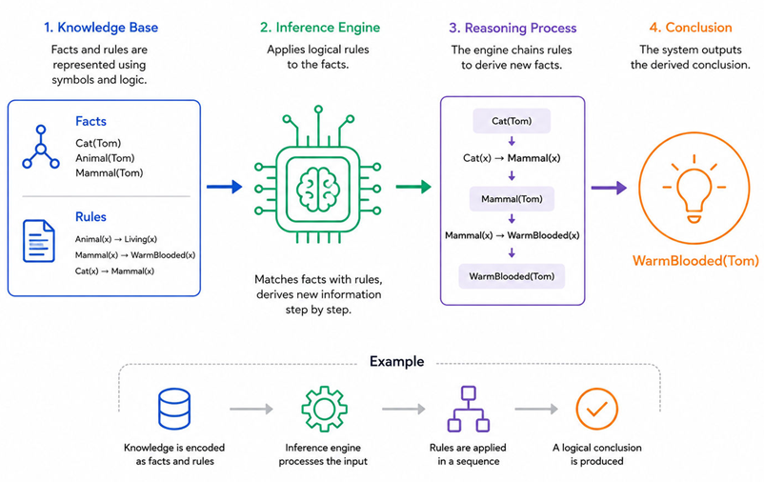
How Symbolic AI Works

Slide 33
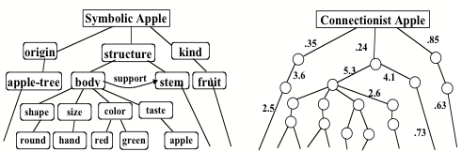
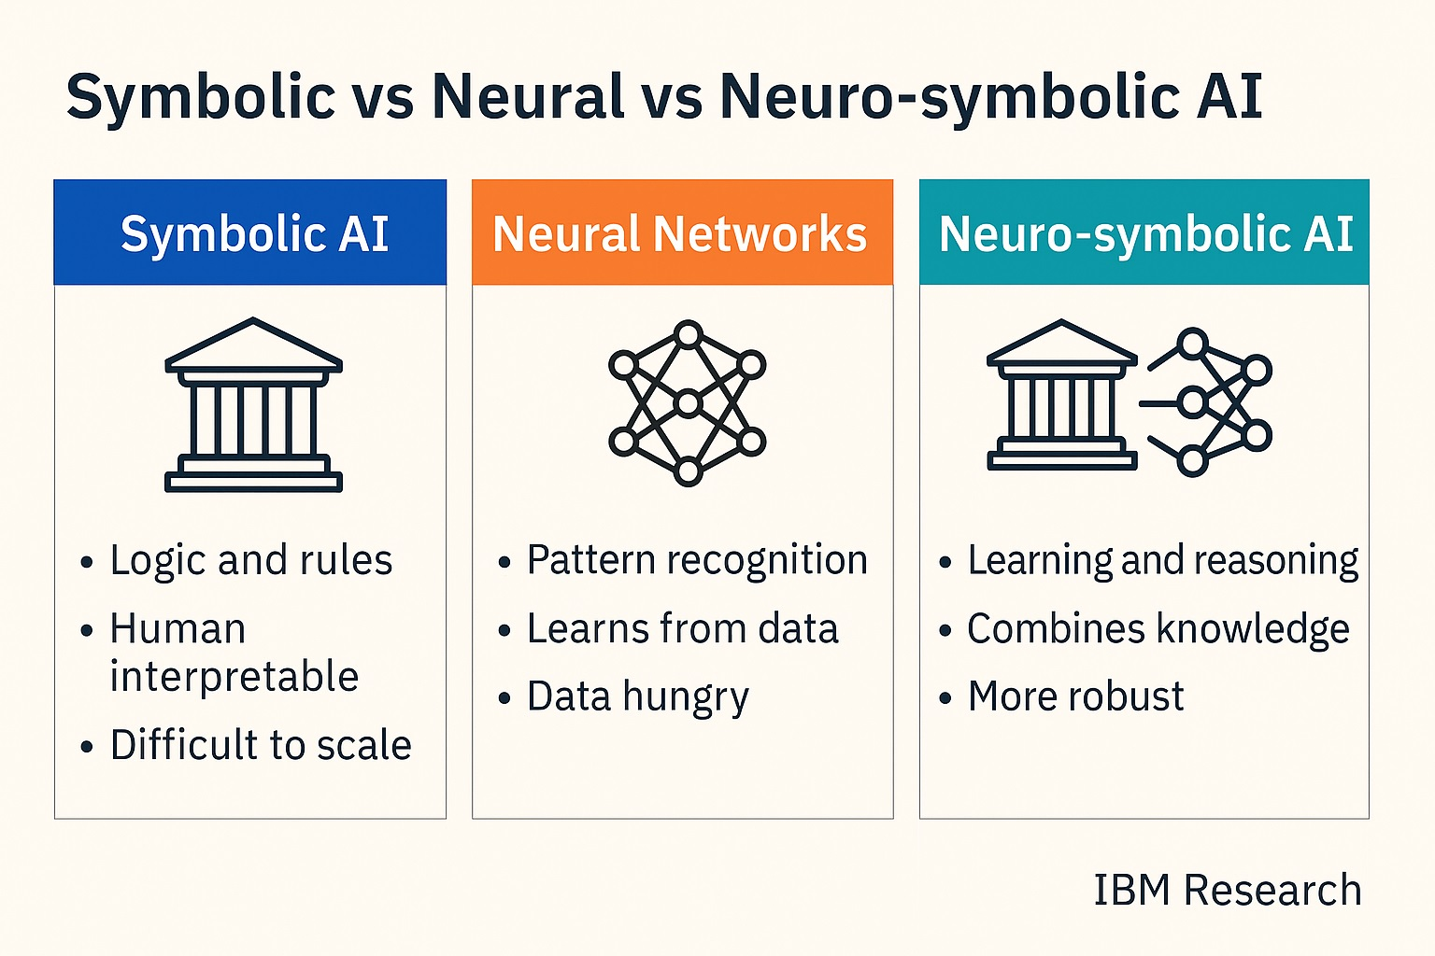
Sub-Symbolic (or Connectionist) AI - Examples
Neural networks
  – Inspired by biological models
  of human brain
  – Ability to learn
Evolutionary /Genetic Algorithms
  – Inspired by biological models
  of human genes
  – Ability to search and optimize
– Operations of Crossover, mutation, fitness
Situated Automata
– Intermediate between the top-down
and bottom-up approaches

Slide 34
Characteristics of Symbolic vs Sub-Symbolic AI Approaches
Top-down style
Knowledge level
  The knowledge needed by the machine is specified
  in the form of rules (top level)
Symbol level
  Represent knowledge in symbolic structures (lists)
  Specify operations on the structures
Implementation level
  Actually implement symbol-processing operations
Bottom-up style
Knowledge Level
Concept of signal strength (connection between symbols) is appropriate at low level
Symbols Ground
Agent’s behaviours interact with the environment to produce complex behaviours
  Like ants colonies or honeybees in their beehives
Implementation: Human Intelligence Simulation approach
    Intelligence evolved after a million years of life
    Many of the similar evolutionary steps needed to make intelligent machines
Emergent behaviour
due to interaction of agent with its dynamic environment

Slide 35
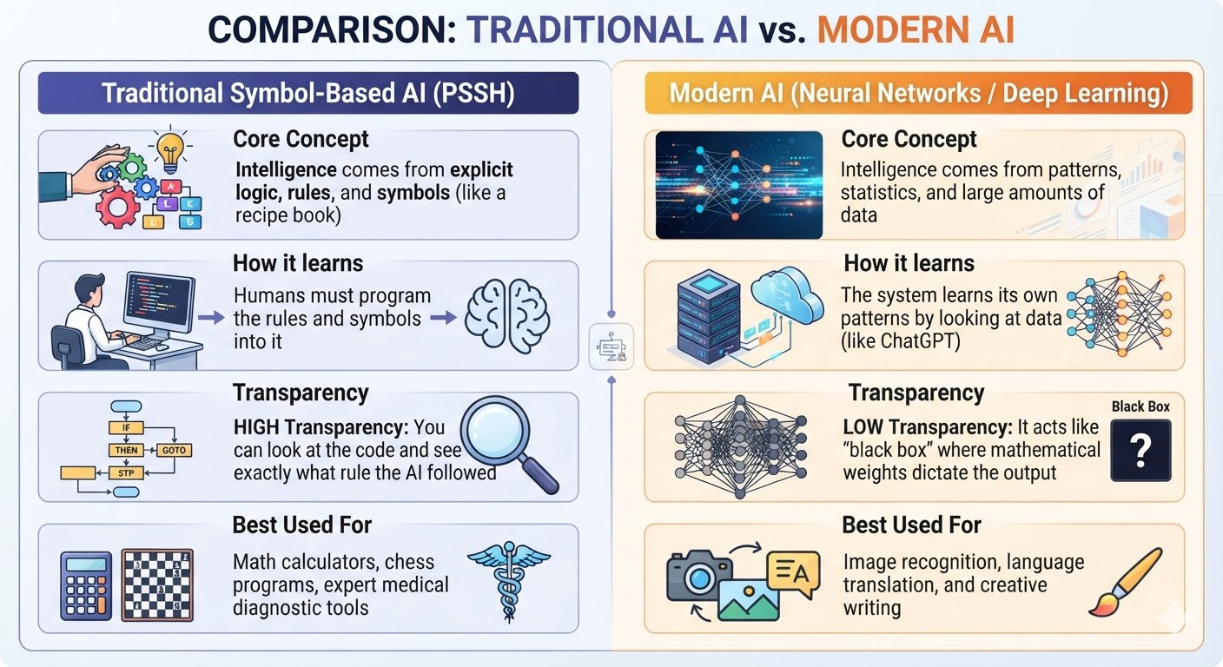
Comparison w.r.t. Physical Symbol System

